Slide 1
Forecast Analysis
Market strategy: Accurate projections of consumer demand and market trends inform which segments to target and how to pitch products and services.
Production planning: Forecasts drive decisions on production volumes, helping to balance inventory costs with the ability to meet customer demand.
Supply chain management: Predicting resource availability, supplier dependability, and the constraints on both is crucial for maintaining smooth operations and controlling costs.
Human resources: Workforce planning relies heavily on forecasts for future business needs and labor conditions.
Financial planning: Projections of revenue, costs, and market conditions underpin budgeting and investment decisions.
Forecasting – the process of using historical data to predict the future.

Slide 2
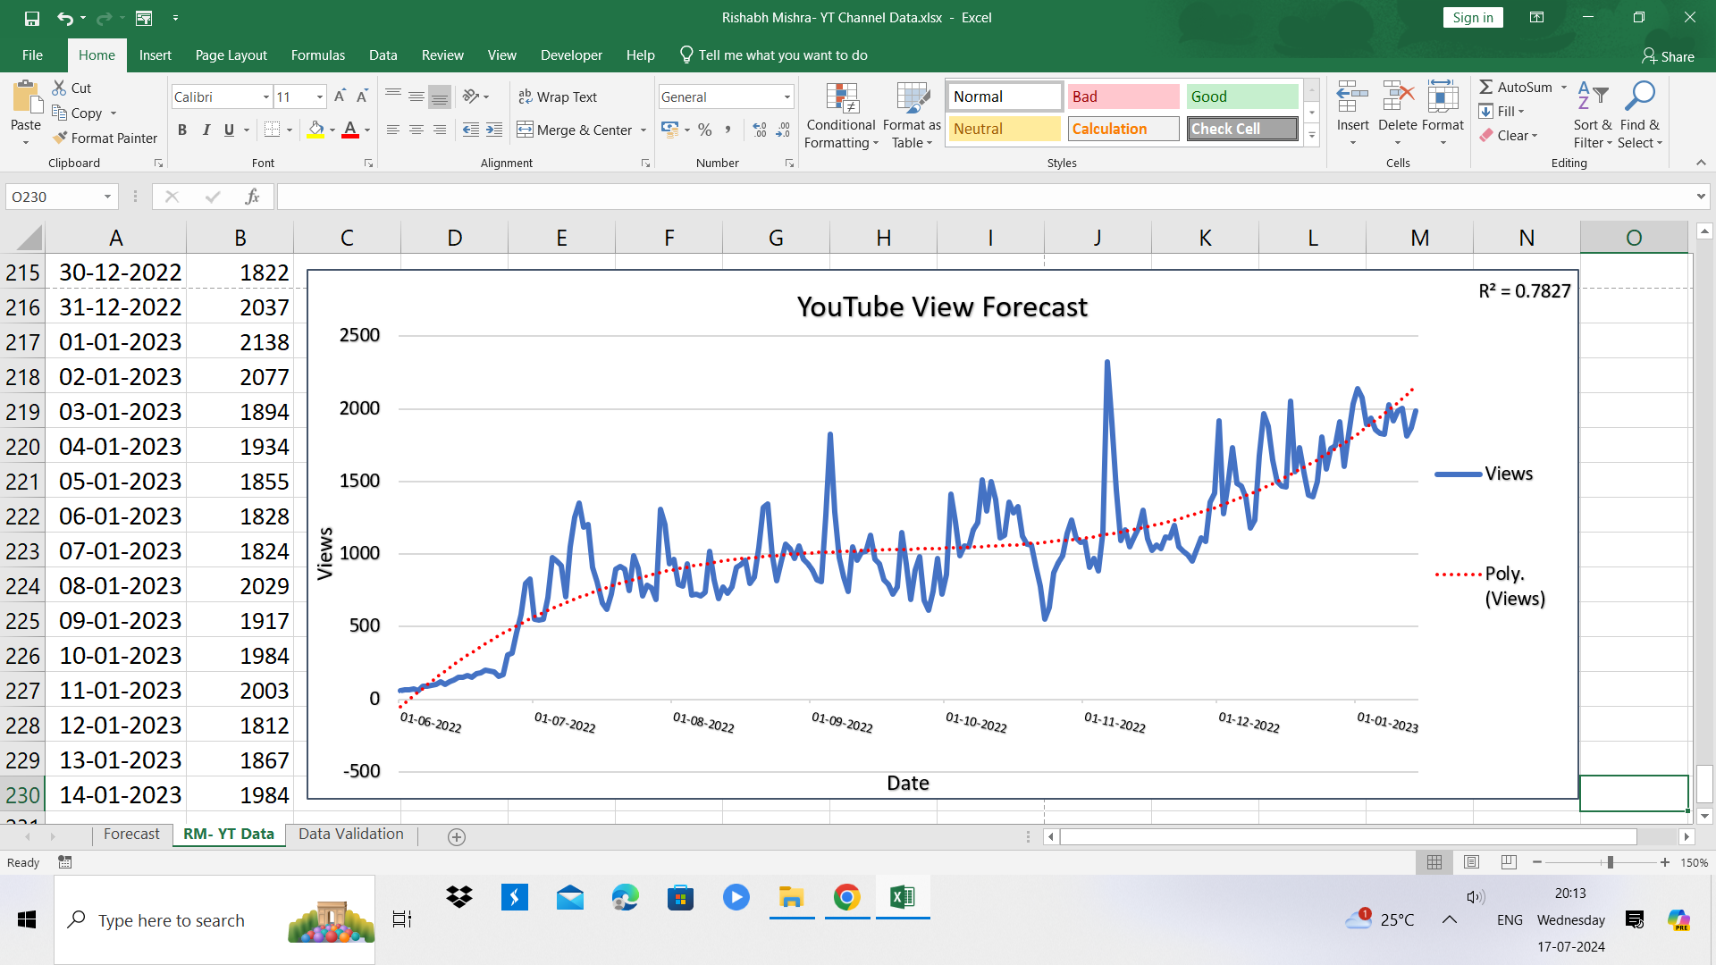
Trend Identification Using Line Graph

Slide 3
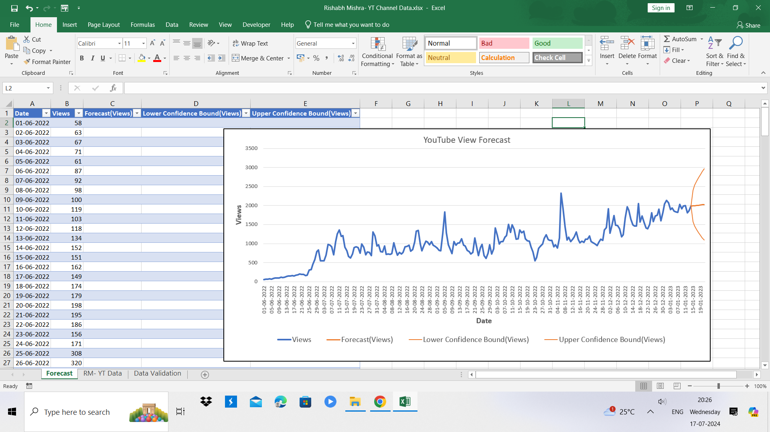
Forecast Sheet Setup and Methodology

Slide 4
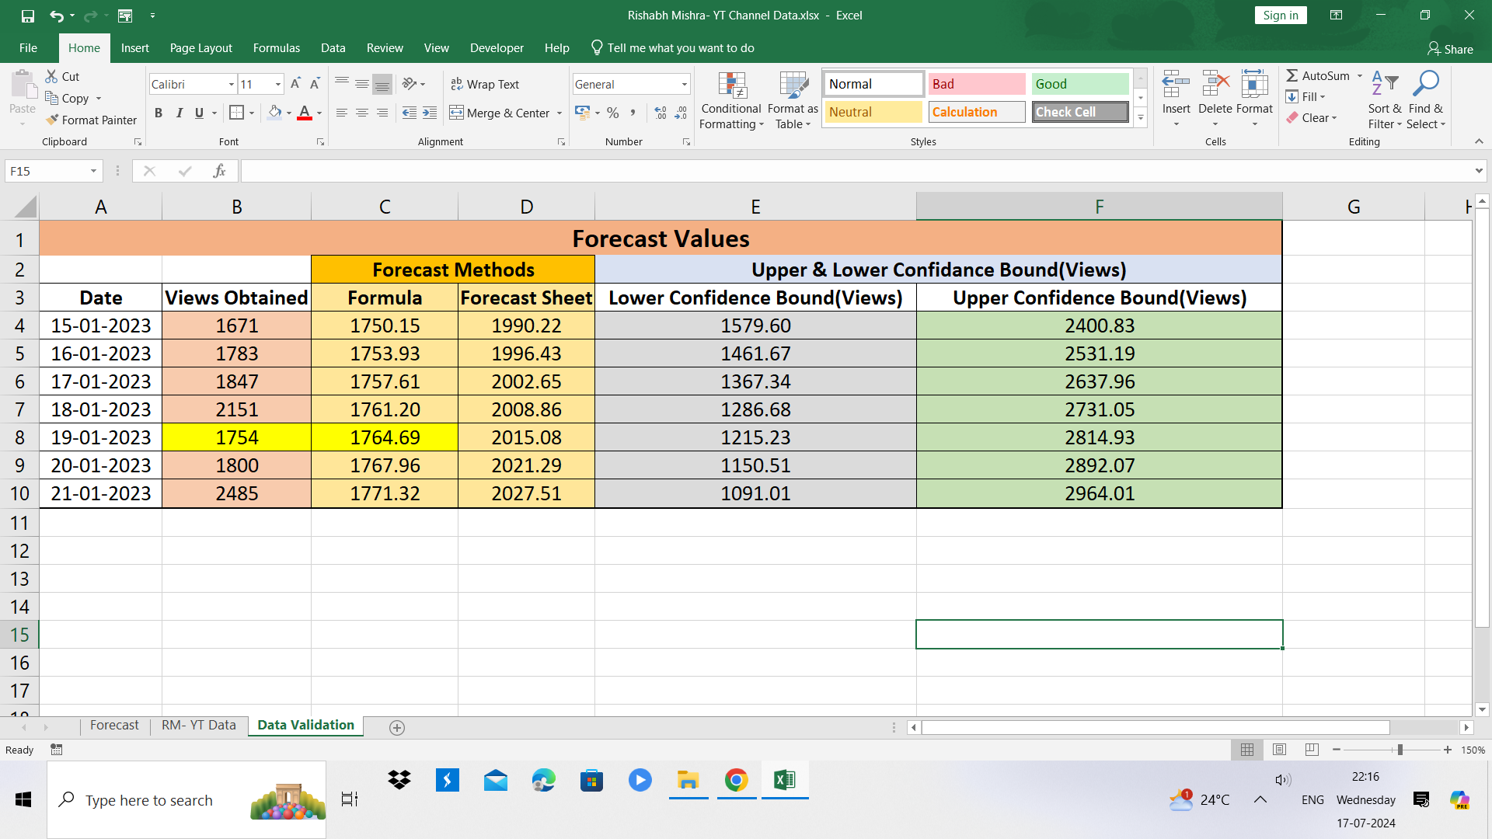
7-Day View Prediction Results

